Slide 1
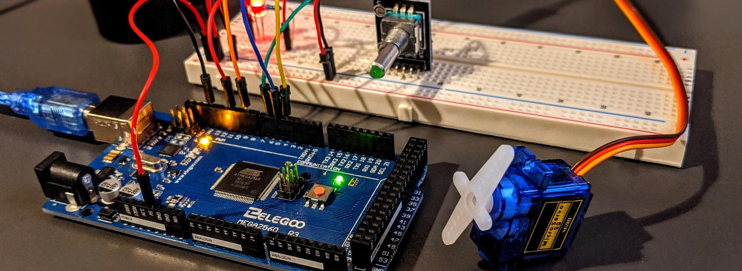
Remote Earthquake Alert System with IoT
EEE 415- Microprocessor and Embedded Systems Laboratory Level 4 Term I Section-A2
Final Presentation
Submitted by – Group 6
Lab Group- A2
Tanvir Hossain
1906040
Tasmin Khan
1906055
Md Hasib Ur Rashid
1906059
A.K.M. Anindya Alam
1906065

Slide 2
Outline
Theoretical Background
Overview of Project
Hardware Design
Coding
IoT Integration
Outputs
Novelty
Limitations
Further Work
Presented by: 1906059

Slide 3
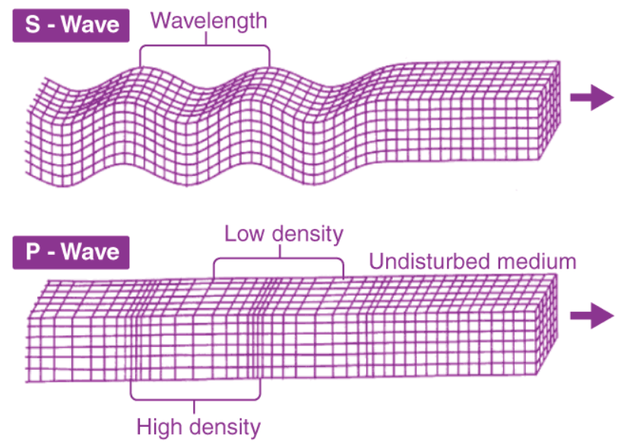
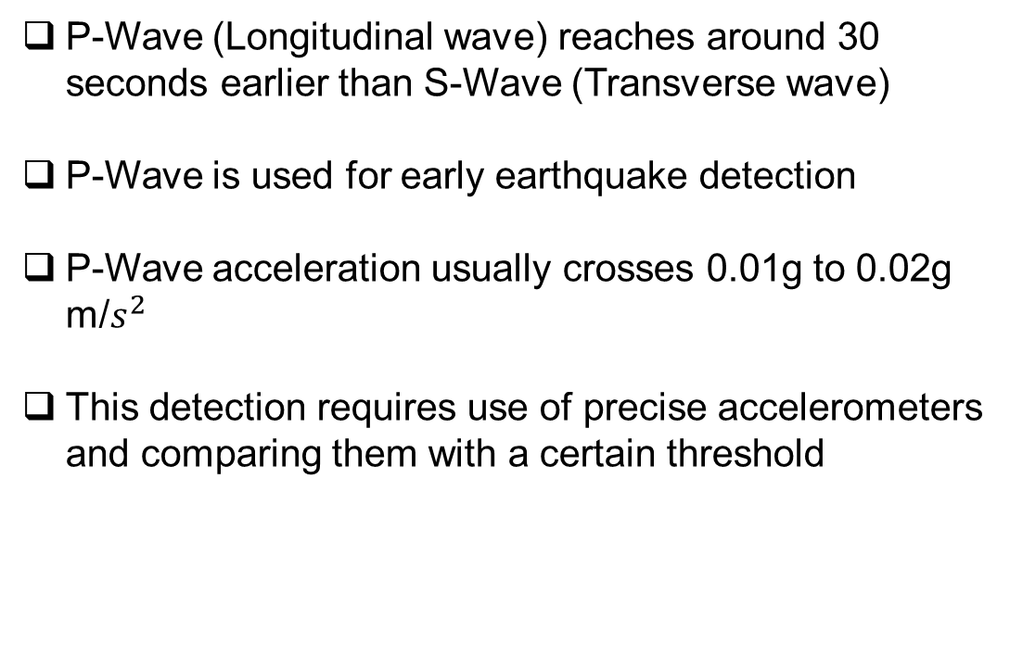
1. Theoretical Background
P-Wave (Longitudinal wave) reaches around 30 seconds earlier than S-Wave (Transverse wave)
P-Wave is used for early earthquake detection
P-Wave acceleration usually crosses 0.01g to 0.02g m/$s^{2}$
This detection requires use of precise accelerometers and comparing them with a certain threshold
Presented by: 1906059

Slide 4
2. Overview of Project
MPU 6050 and ADXL accelerometers were tested for the project
Accelerometer data was compared with a threshold and crossing the threshold resulted in alert
When earthquake was detected, pre-trigger data of 30 seconds and post-trigger data of 1.5 minutes was stored in the SD card locally and uploaded to IoT interface for future analysis
The IoT interface connected the ESP32 on the detection side to that of the load side and remotely disconnected the loads for safety measures after successful detection
It also sent E-Mail and WhatsApp alerts to the subscribers of the system
The data analytics can also be accessed by the users using an app, developed using MIT App Inventor
Presented by: 1906059

Slide 5
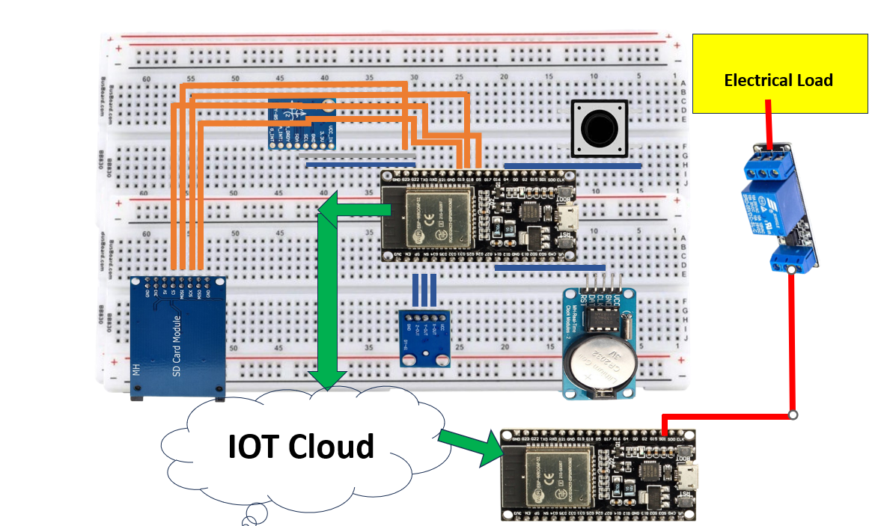
3. Hardware design
ESP32
MPU6050
RTC module
SD card module
Capacitor
Pushbutton
LED
Relay and loads
Presented by: 1906059

Slide 6
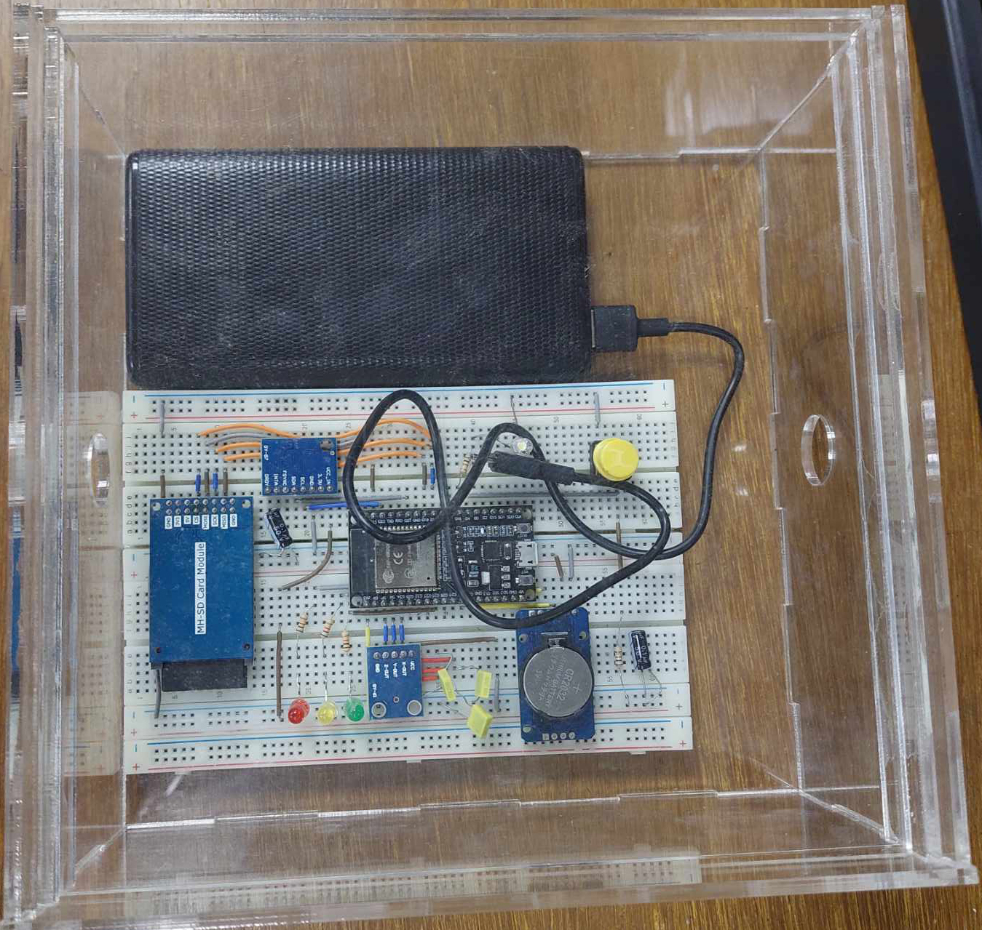
3.1 Detection
White LED is ON when the system is being calibrated
The green LED is ON during zero-earthquake condition
Two crossings of threshold (0.01g) by the accelerometer data triggers the alert system to reduce false detection
Red LED is ON after detection
Pre-trigger data of 30 seconds and post-trigger data of 1.5 minutes is stored locally in SD card
The data is also sent to IoT platform Blynk using timestamps from RTC module
Presented by: 1906040

Slide 7
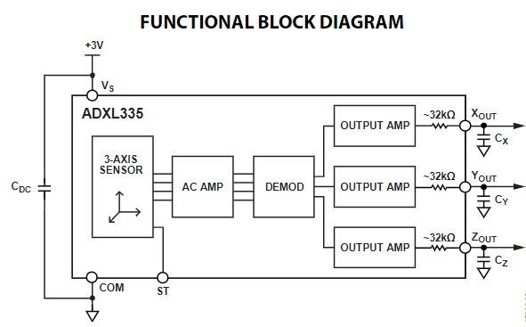
3.2 Sensor Selection
A single 0.1uF capacitor is placed close to the ADXL 335 supply pins to decouple the accelerometer from noise on power supply
MPU6050 provides digital output of 6-axis data and has a programmable range up to +- 16g
Both ADXL 335 and MPU 6050 were tested
Presented by: 1906040

Slide 8
3.2 Sensor Selection (Contd.)
During no earthquake event, ADXL showed noise of around 40 milli g
During no earthquake event, MPU6050 showed around 3-4 milli g of noise, performing about 10 times better than ADXL
Use of MPU6050 allowed us to reduce the threshold even lower without risking false detection due to noise
Presented by: 1906040

Slide 9
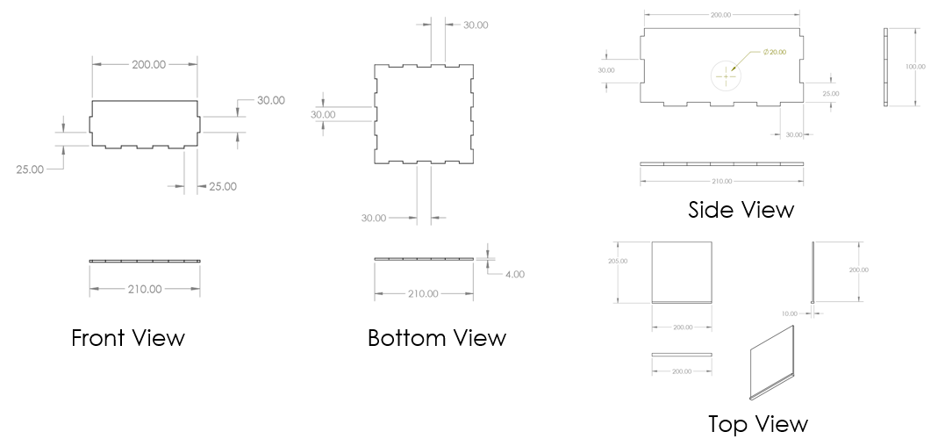
3.3 Casing Design
A case for the device was designed using CAD for testing and protection purposes
The case was constructed using rigid structures so that its vibration does not affect the vibration detection of the sensors
Presented by: 1906040

Slide 10
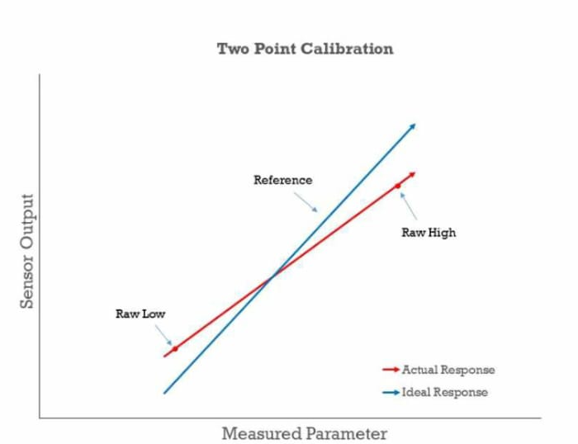
4.1 Calibration of sensor
2 point calibration involves calibrating the data in reference to two points, usually maximum and minimum
Maximum and minimum values of accelerometer along the axes were taken as g and –g respectively
The digital input data from the accelerometers was calibrated in reference to the straight line connecting maximum and minimum values
Even after calibration, a base offset value was present during no-earthquake condition
The average value of the accelerometer readings for a 10 second period was used to deduct the offset value from readings for final dataset
Presented by: 1906055

Slide 11
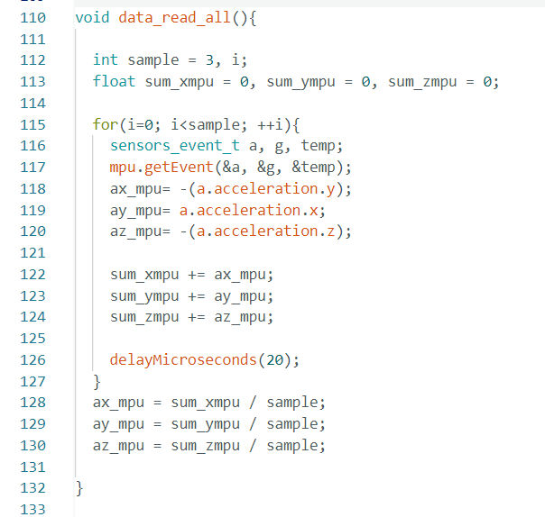
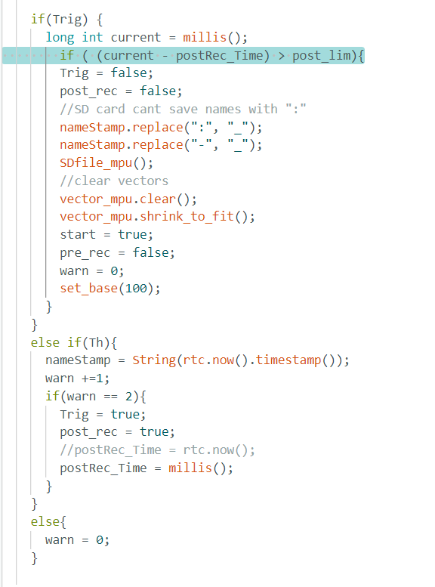
4.2 Main Code Snippet
Presented by: 1906055

Slide 12
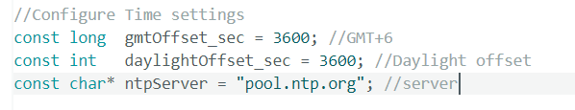
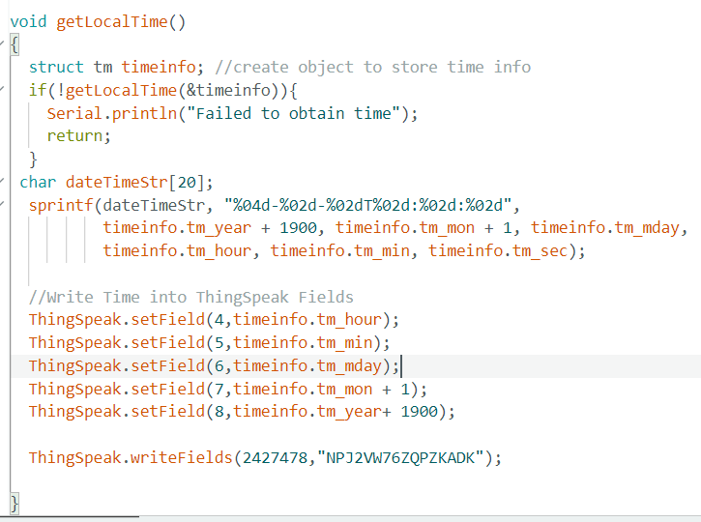
4.3 Earthquake time calculation
Presented by: 1906055

Slide 13
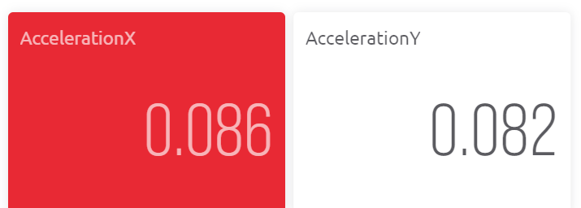
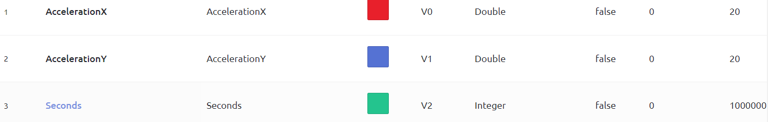
5.1 Load Disconnection using IoT
After successful detection, the device disconnects remote electrical and other vulnerable loads
Remote loads are connected to a separate microprocessor using relays
Blynk IoT platform is used to connect the detection end ESP-32 to the load end ESP-32
When earthquake is detected, detection end ESP-32 sends a detection signal to Blynk and turns the virtual pin on the platform off
Turning off the virtual pin causes the load end ESP-32 to turn off the load on the load side using relay
Accelerometer data in Blynk
Virtual pin list in Blynk
Presented by: 1906055

Slide 14

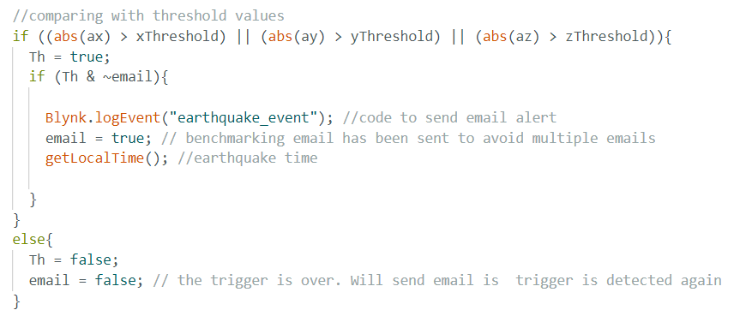

5.2 Alert system using IoT
Blynk can also be used to send an email alert to the subscribers of our system
CallMeBot IoT platform has been used to send WhatsApp text message alert to the users after detection
Email alert post-earthquake
WhatsApp alert post-earthquake
Code snippet for email alert
Presented by: 1906065

Slide 15
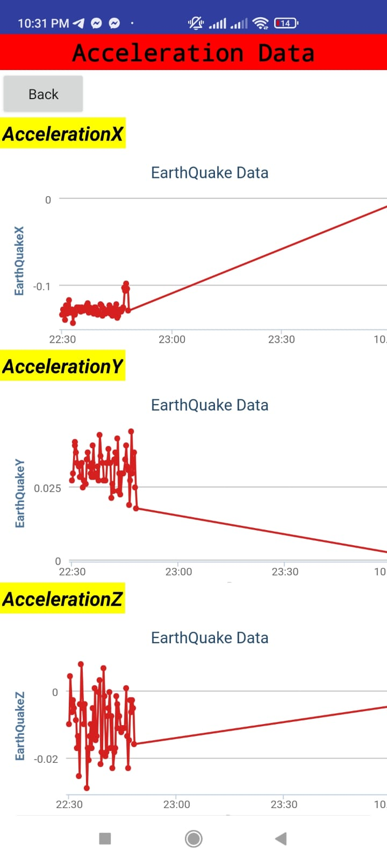
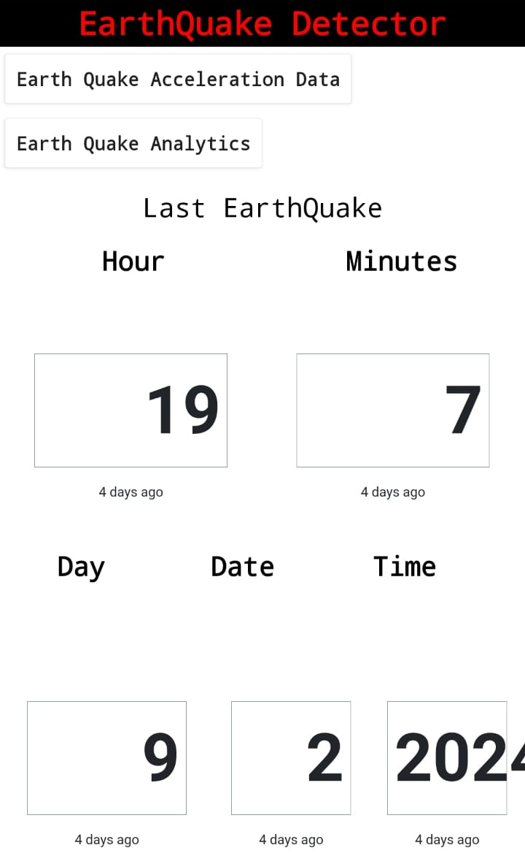
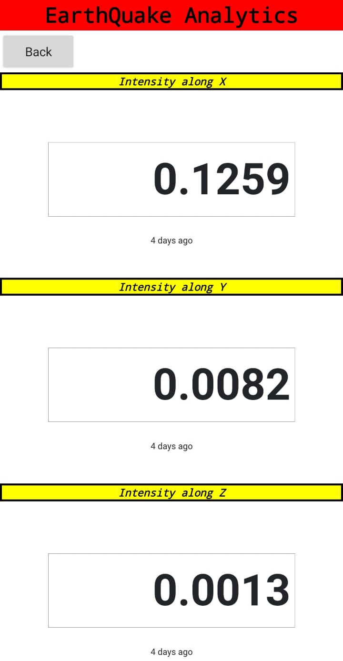
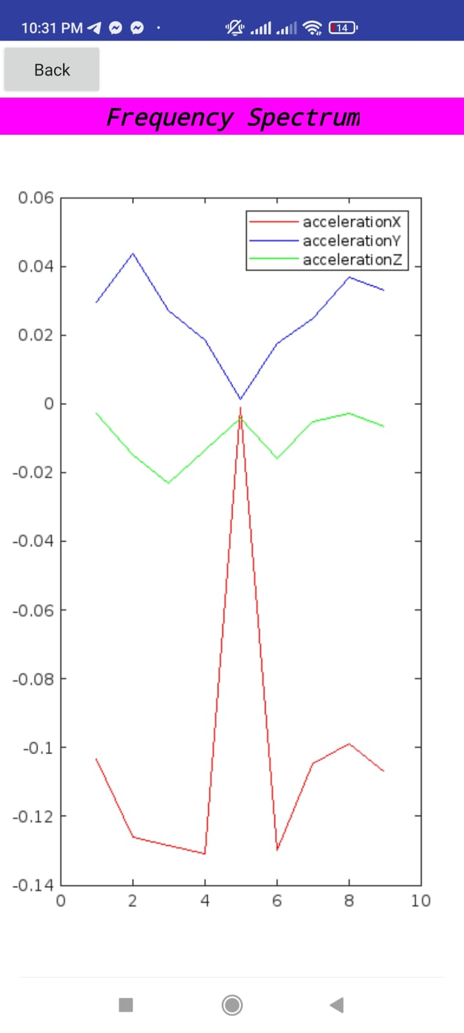
5.3 Data access using App
ThingSpeak was used to calculate and plot intensity of accelerometer data using FFT and Perseval’s Theorem
An app was developed using MIT app inventor which allows the users to
- Observe time of earthquake
- Observe accelerometer data along X,Y and Z axes
- Observe frequency spectrum and intensity data of the seismic event
This app was used as an interface for visualization of the ThingSpeak output plots
Presented by: 1906065

Slide 16
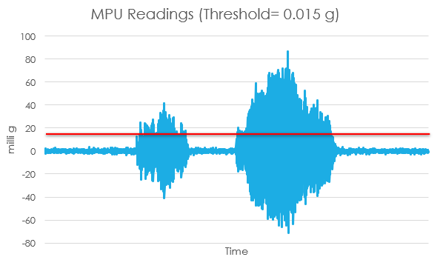
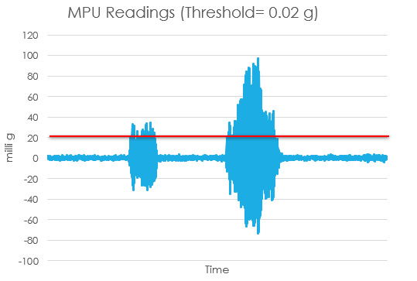
6 Outputs
ADXL output shows higher noise
MPU6050 with lower noise allows us to reduce the threshold even lower for more precise detection
Presented by: 1906065

Slide 17
7 Novelty
Data storage: Data saved 30 seconds before and 1.5 minutes after trigger for post analysis of data due to flash memory limitations
Calibration: 2 point calibration
Reduction of noise:
- Average of 3 consecutive readings to minimize noise fluctuations
- Use of capacitors to reduce noise
Double check: 2 crossings of threshold considered to reduce unwanted noise spikes
Data visualization: Data monitoring and analysis using IoT platform
Load disconnection: Remote load disconnection over IoT
Presented by: 1906065

Slide 18
8 Limitations
Sensor limitations: ADXL335 is very noise prone. MPU6050 is better but using Piezoelectric sensors instead of MEM sensors can give better accuracy
Flash memory limitations: Pre-trigger and post-trigger data saving time limited due to low flash memory of ESP32
IoT platform user limitation: Unsubscribed use of IoT platforms limits the number of devices that can be integrated
Data transfer delay: Limited data rate during transferring data to IoT platform
Lack of testing resources: Proper testing with shaker table could help develop the device
Presented by: 1906065

Slide 19
9 Further Opportunities
Testing using Shaker Table: A possible collaboration with Department of Civil Engineering, BUET could help in analyzing the threshold for the device for further improvement
Use of high-end sensors: A more precise high-end sensor could help in more accurate detection of earthquakes
Development of subscription model: A subscription model for our system could help us expand the network and use high end IoT platforms
Presented by: 1906065

Slide 20
THANK YOU
Any Questions?
Presented by: 1906040

